Slide 1
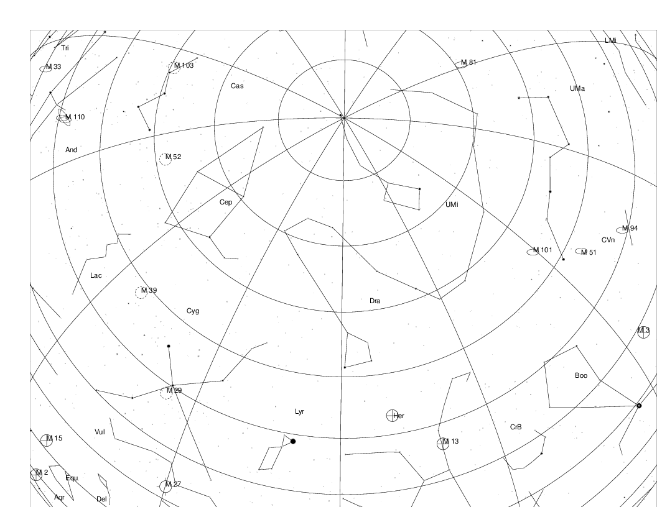
Year 2000 AD

Slide 2
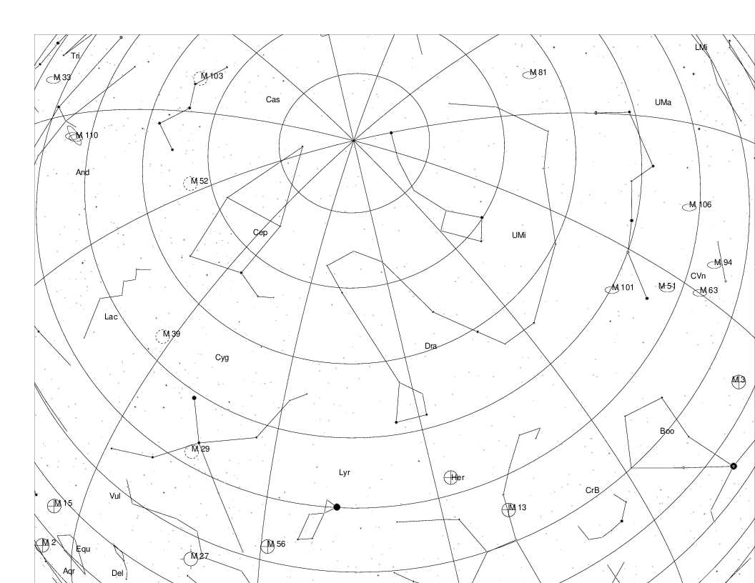
Year 3000 AD

Slide 3
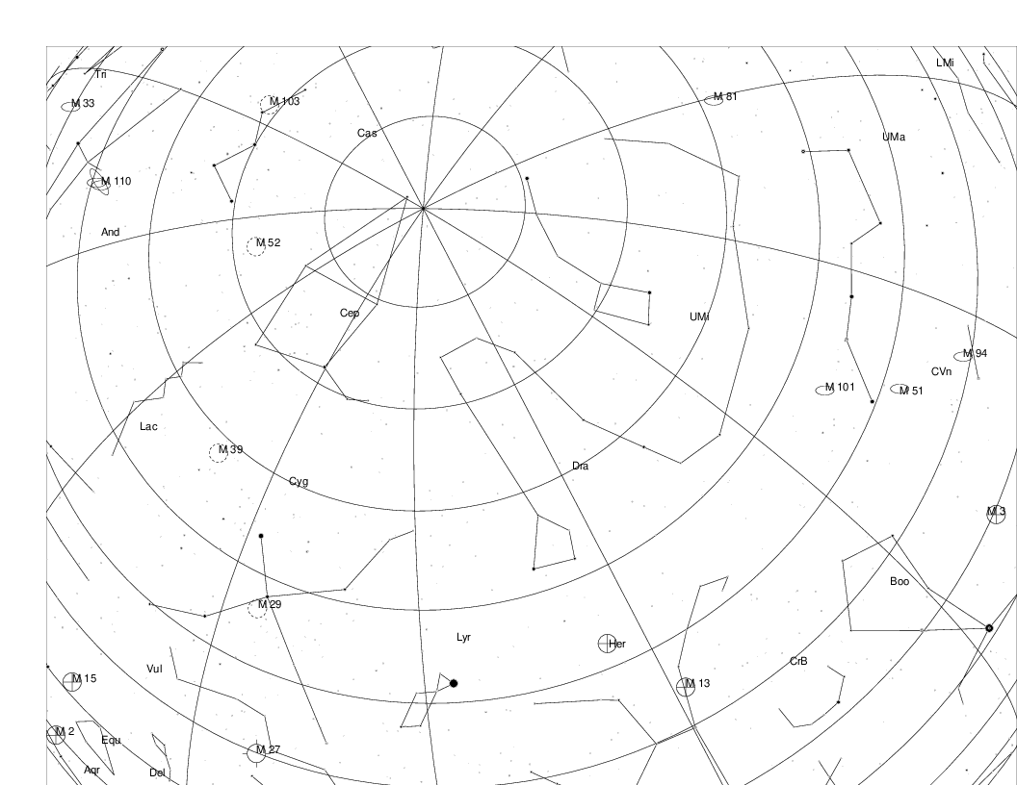
Year 4000 AD

Slide 4
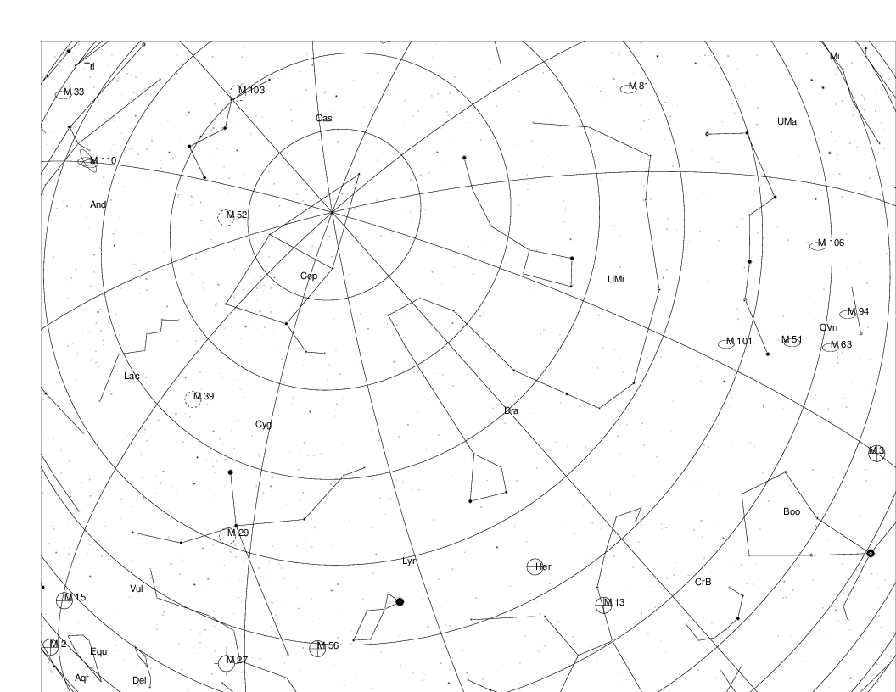
Year 5000 AD

Slide 5
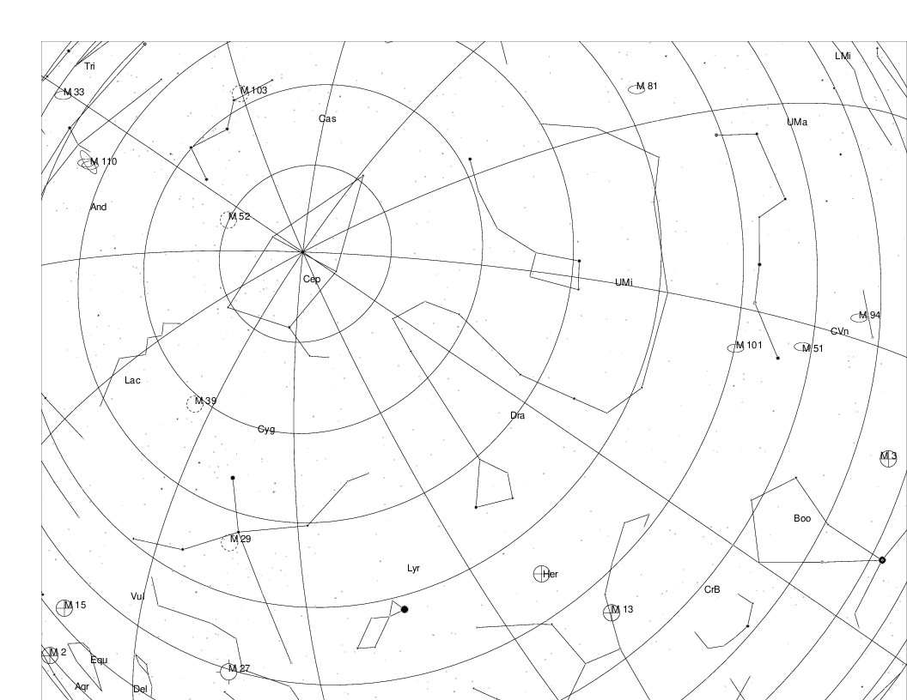
Year 6000 AD

Slide 6
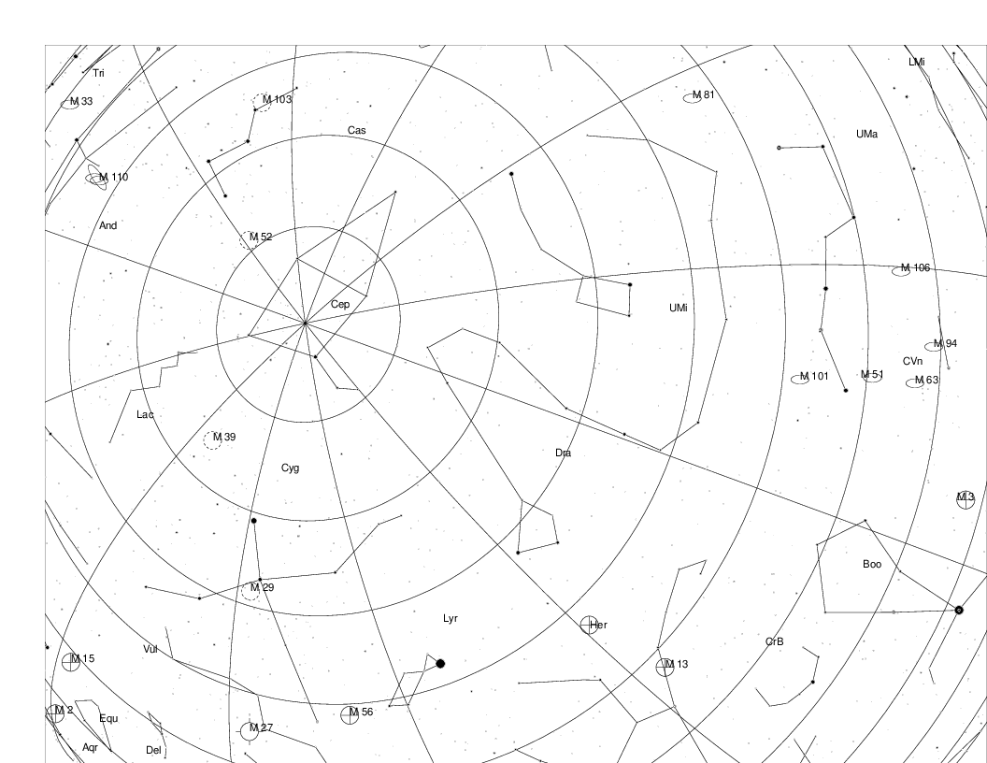
Year 7000 AD

Slide 7
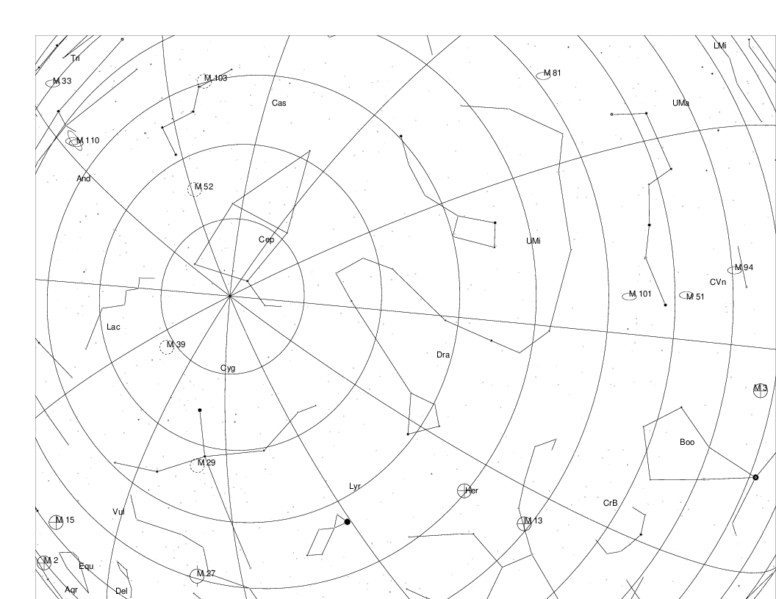
Year 8000 AD

Slide 8
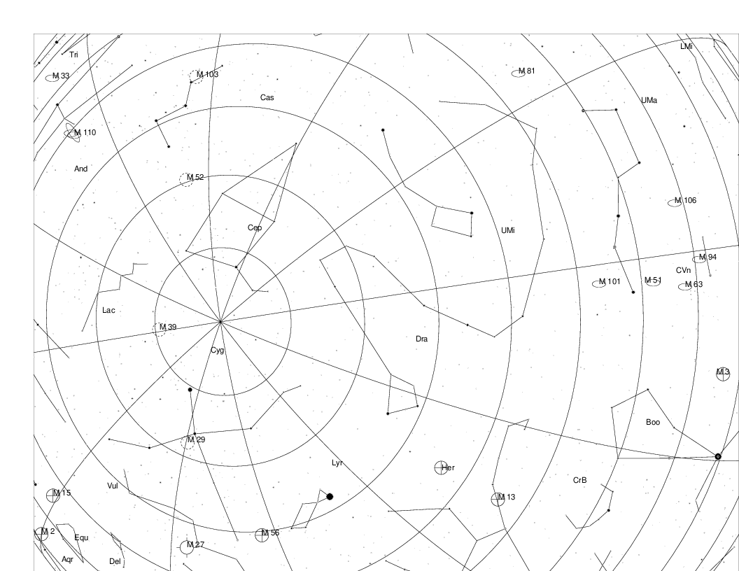
Year 9000 AD

Slide 9
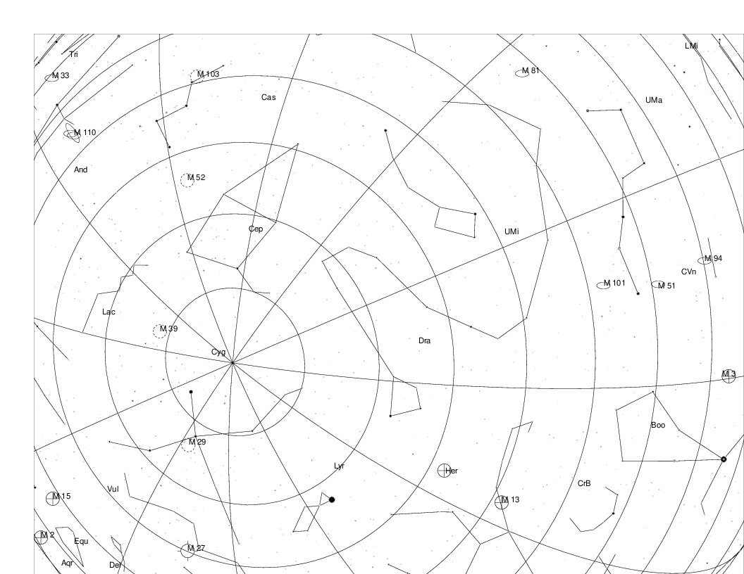
Year 10,000 AD

Slide 10
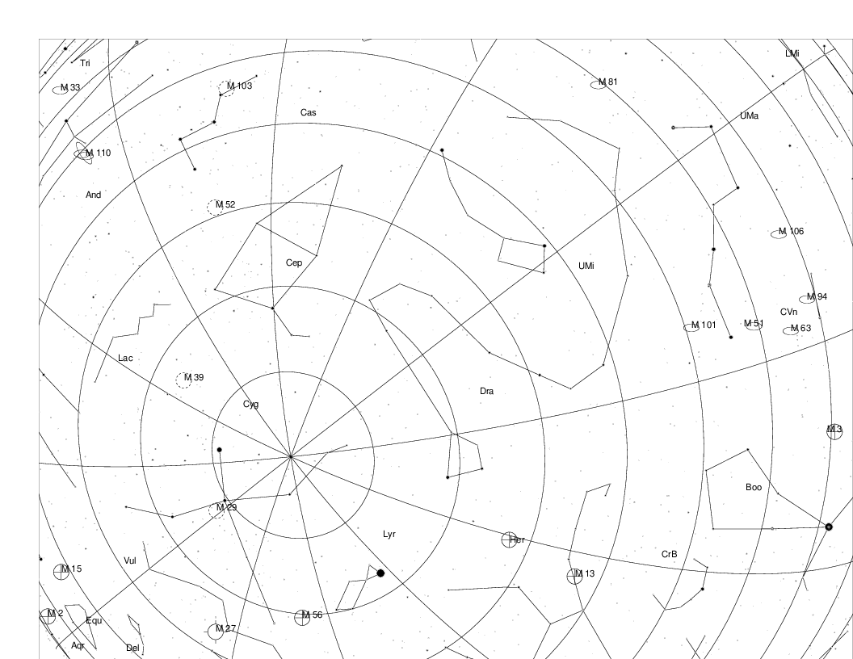
Year 11,000 AD

Slide 11
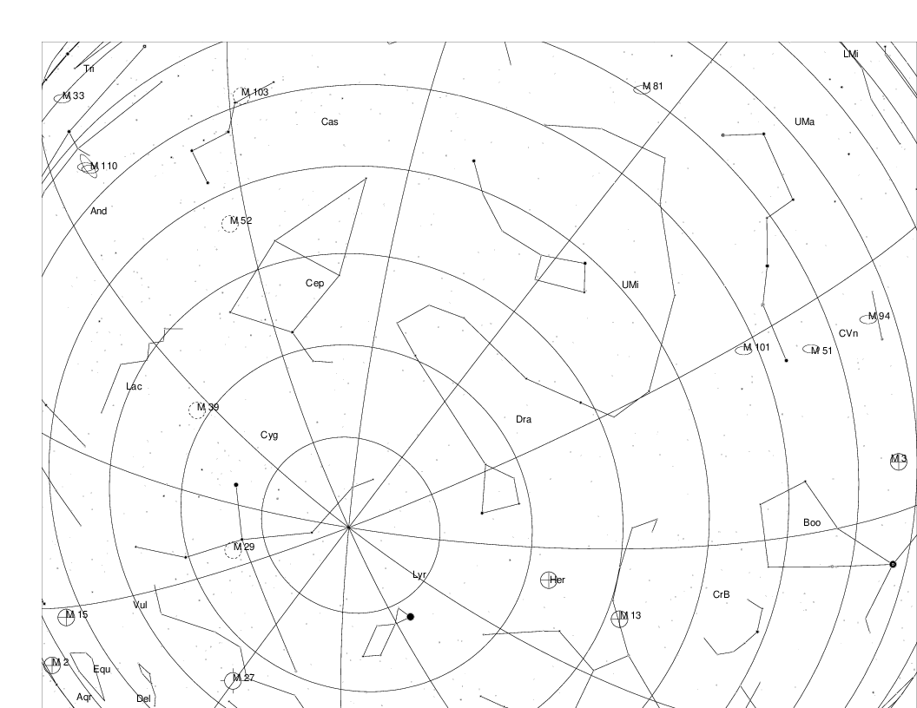
Year 12,000 AD

Slide 12
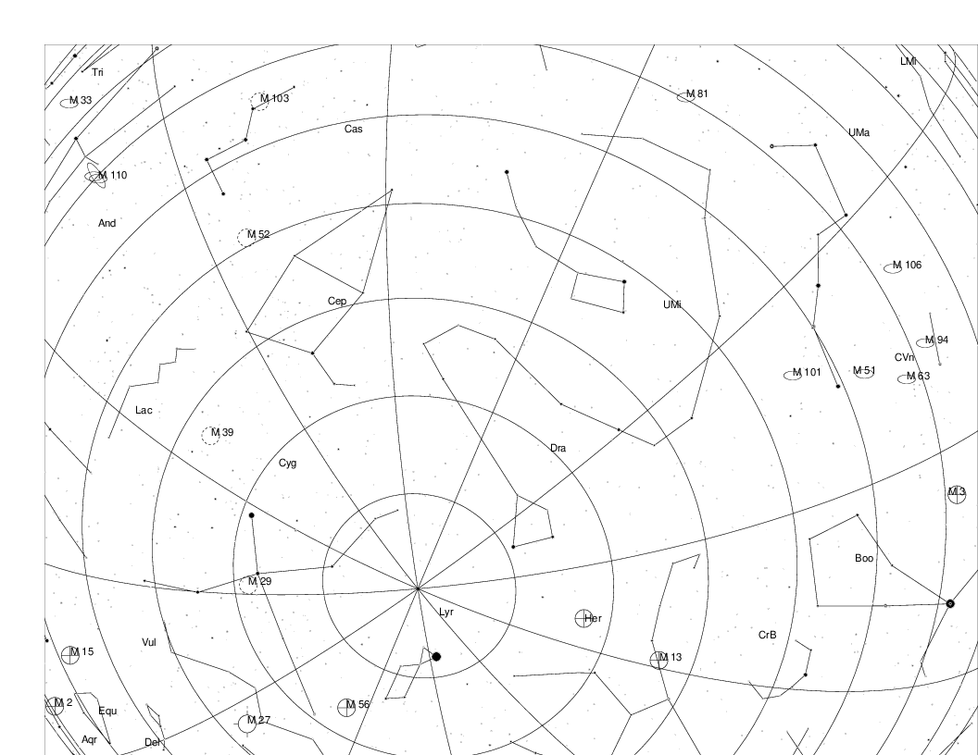
Year 13,000 AD

Slide 13
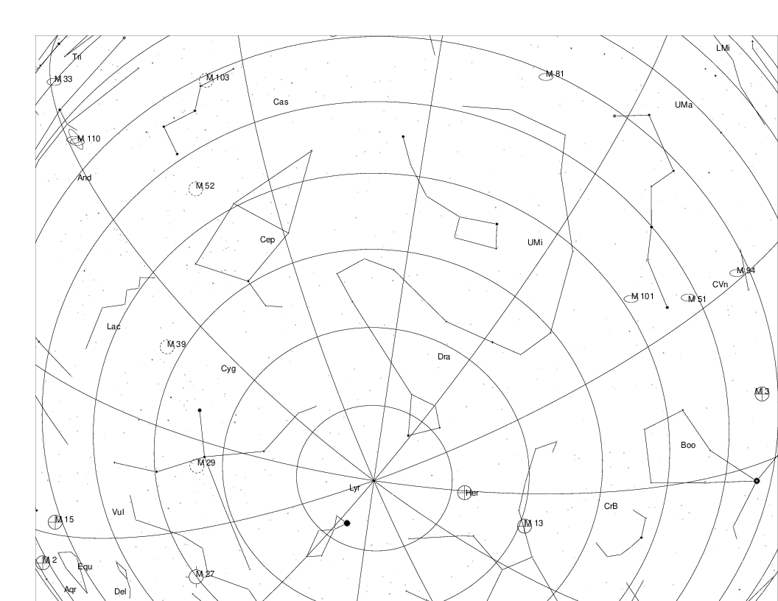
Year 14,000 AD

Slide 14
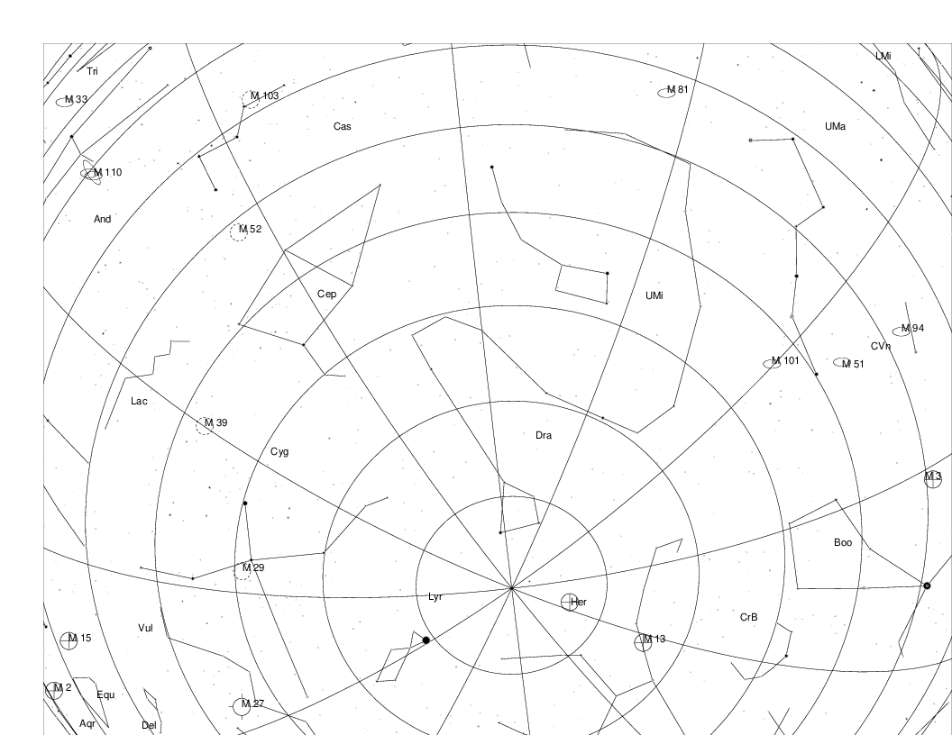
Year 15,000 AD

Slide 15
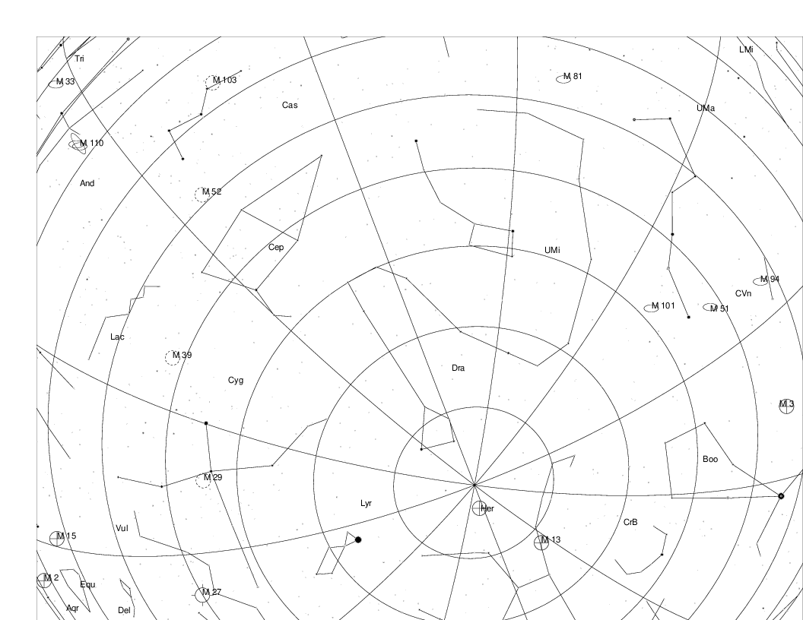
Year 16,000 AD

Slide 16
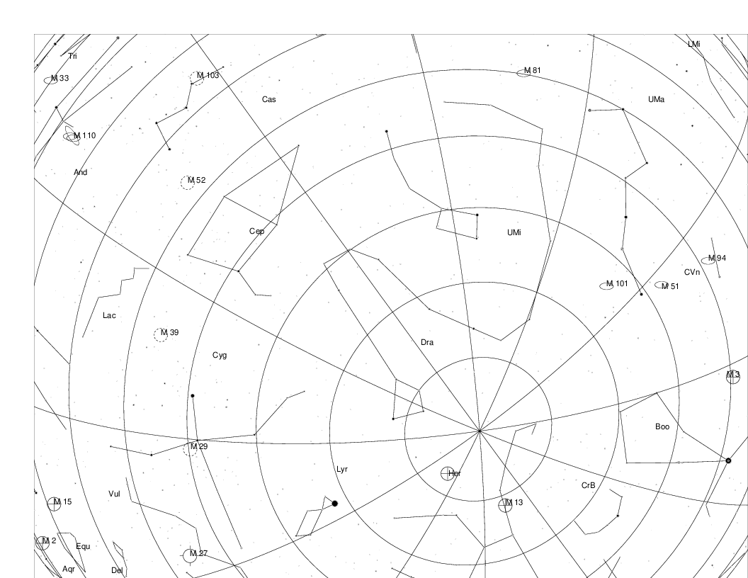
Year 17,000 AD

Slide 17
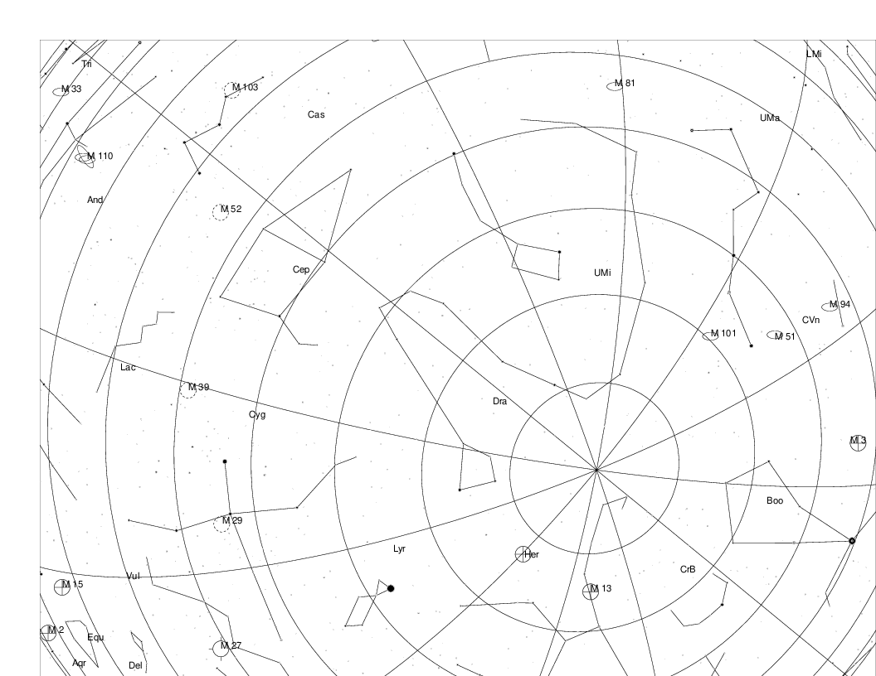
Year 18,000 AD

Slide 18
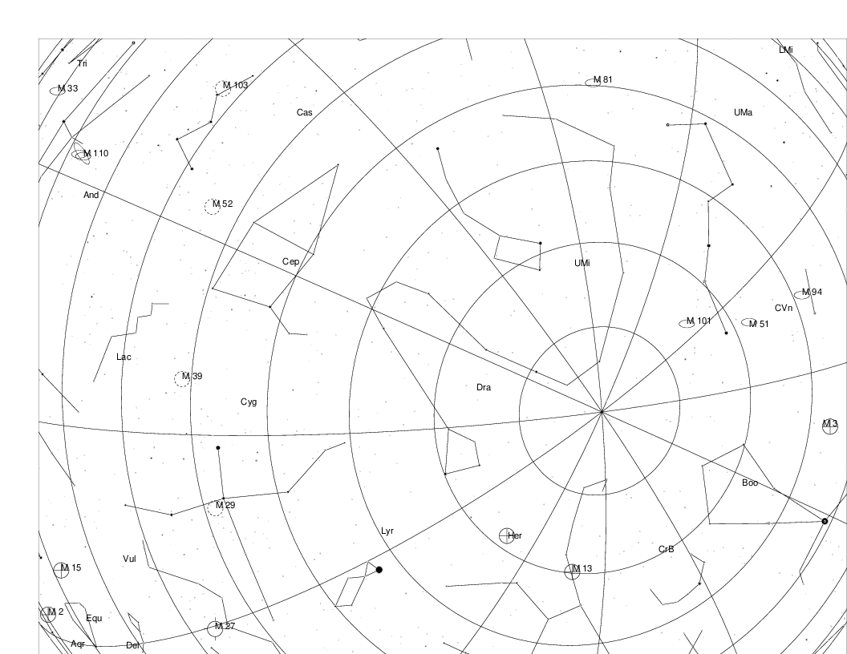
Year 19,000 AD

Slide 19
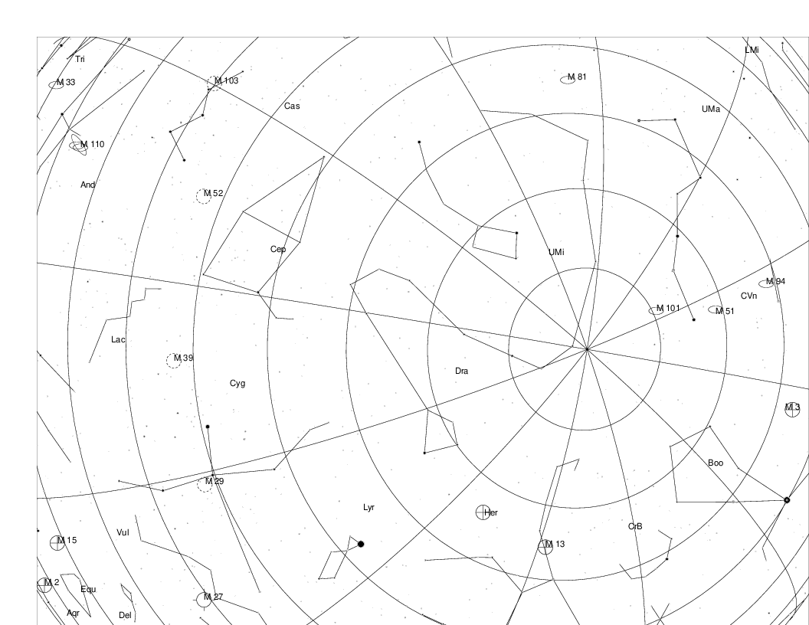
Year 20,000 AD

Slide 20
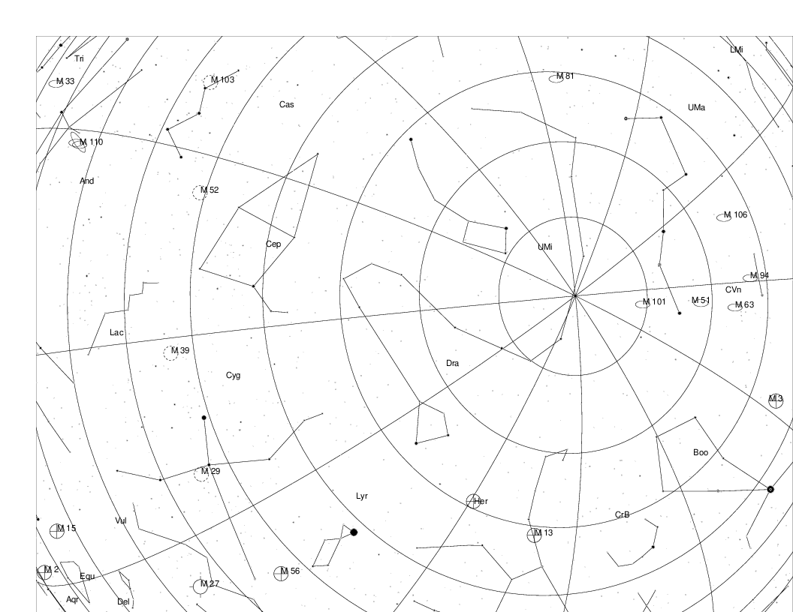
Year 21,000 AD

Slide 21
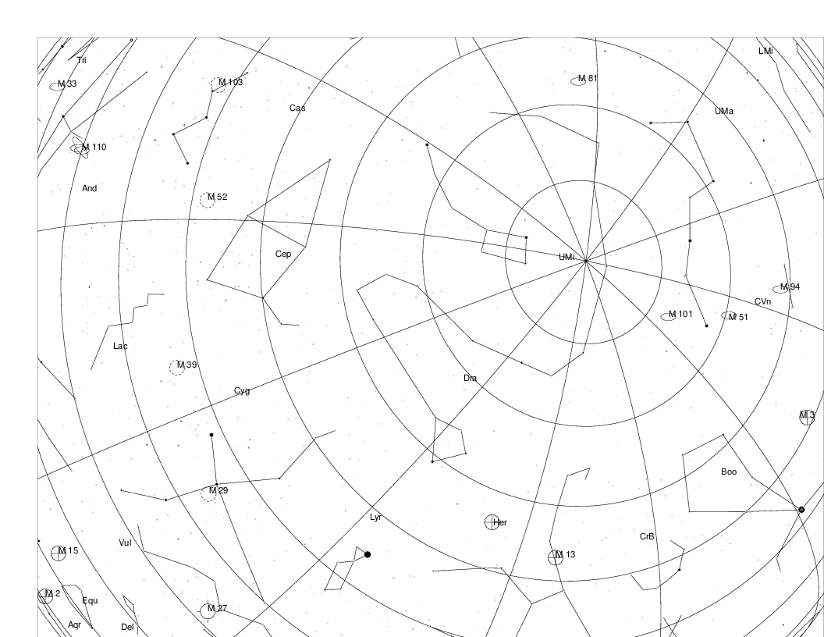
Year 22,000 AD

Slide 22
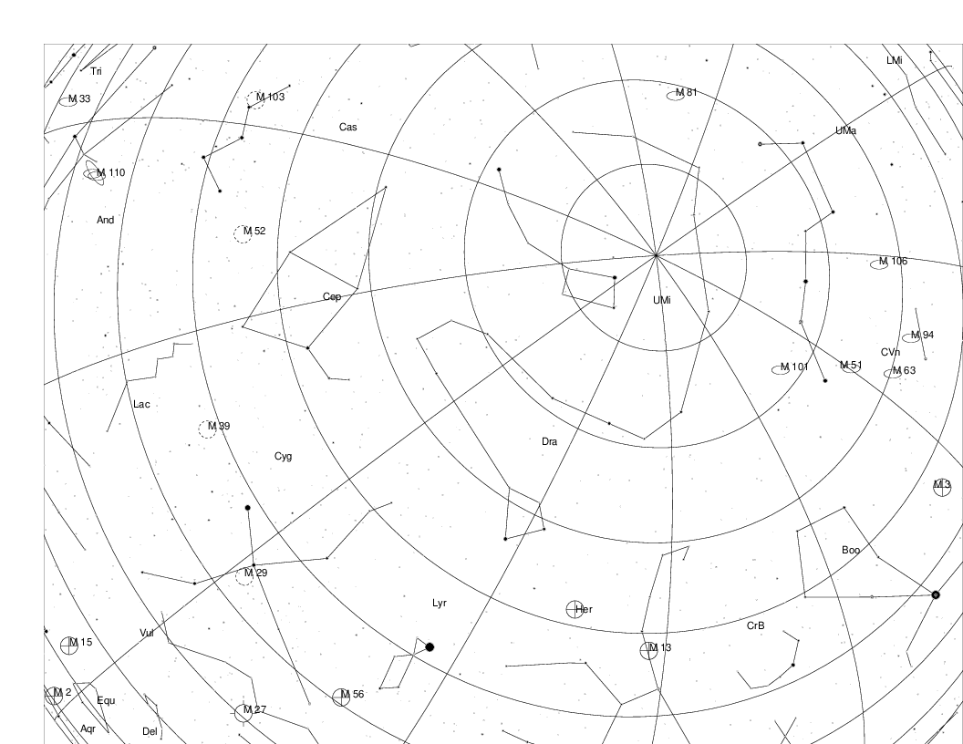
Year 23,000 AD

Slide 23
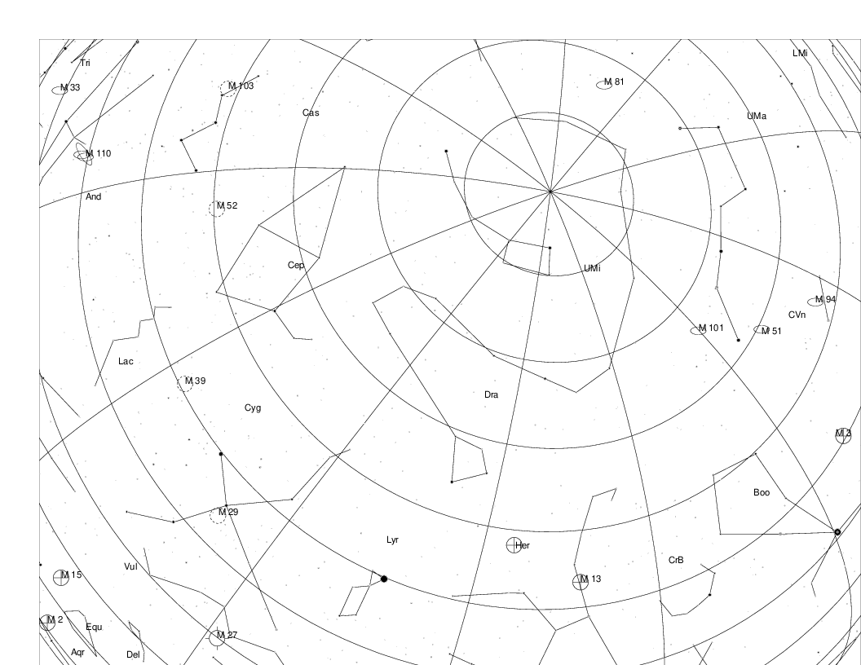
Year 24,000 AD

Slide 24
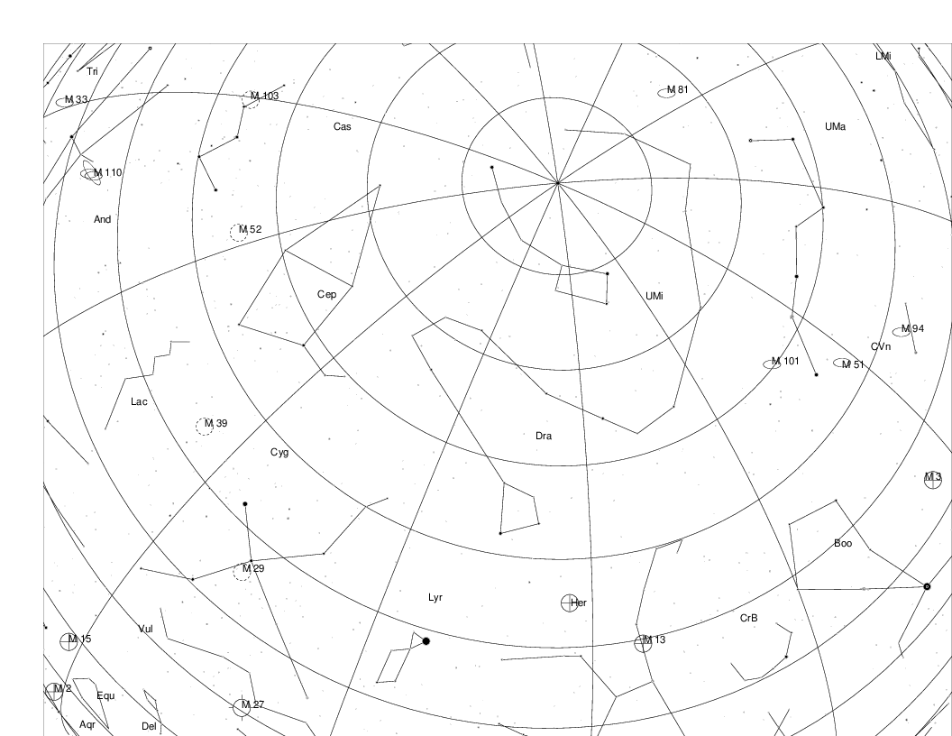
Year 25,000 AD

